Slide 1
Workshop 6 – Deep Learning – Part 1
Advanced Analytics and Applications [AAA]
Information Systems for Sustainable Society (is3) | WiSo Faculty | Univ.-Prof. Dr. Wolfgang Ketter | 5/11/20

Slide 2
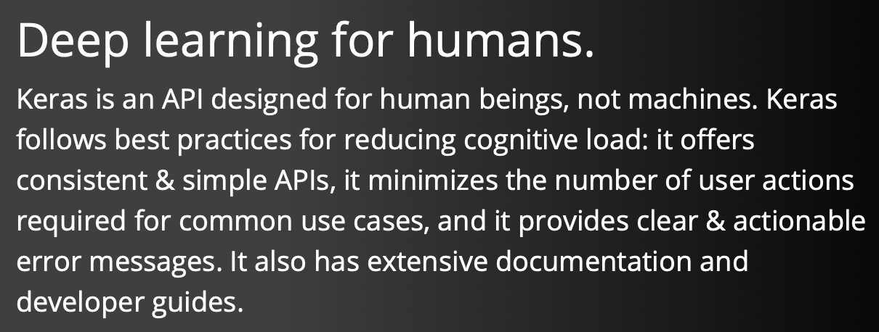

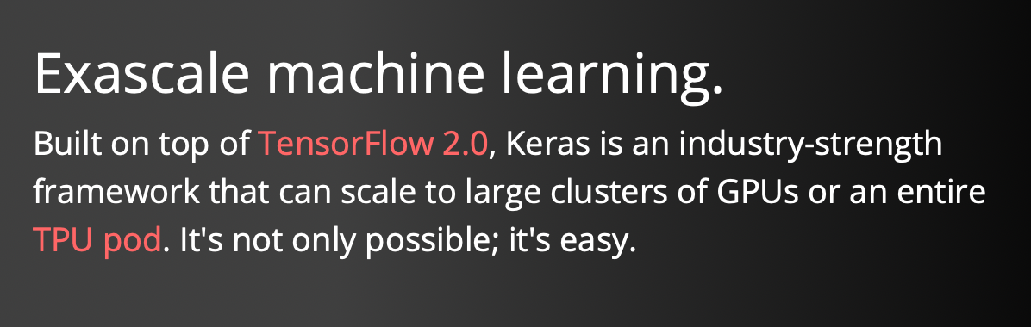
Tools
Keras

Slide 3

Tools
Keras
https://keras.io

Slide 4
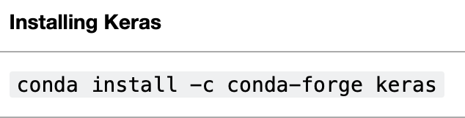
Tools
Keras

Slide 5
Contact
For general questions and enquiries on research, teaching, job openings and new projects refer to our website at www.is3.uni-koeln.de
For specific enquiries regarding this course contact us by sending an email to the IS3 teaching address at is3-teaching@wiso.uni-koeln.de

